Slide 1
Menus
Menus are a major form of navigation through a system and, if properly designed, assist the user in developing a mental model of the system. In this step, the following menu topics will be addressed:

Slide 2
Develop System Menus and Navigation Schemes
The structures of menus.
The functions of menus.
The content of menus.
Formatting menus.
Writing menus.
Navigation using menus.
Web site navigation and links.
Web site navigation elements.
Maintaining a sense of place in Web sites.
Types of menus.

Slide 3
Menus
Menus are effective because they utilize the more powerful human capability of recognition rather than the weaker capability of recall. Working with menus reminds people of available options and information that they may not be aware of or have forgotten.
Experienced system users, while finding menus helpful at first, may find them tedious as they learn the system. Continually having to step through a series of menus to achieve the desired objective can be time-consuming and frustrating. Therefore, the design of menu systems must consider the conflicting needs of both inexperienced and experienced users

Slide 4
Menus
Graphical and Web systems are heavily menu-oriented. They vary in form and are applied in diverse ways. In graphical systems they are used to designate commands, properties that apply to an object, documents, and windows. When selected, a graphical menu item may lead to another menu, cause a window to be displayed, or directly cause an action to be performed
To accomplish these goals, a graphical system presents a variety of menu styles to choose from. Included are entities commonly called menu bars, and menus called pull-downs, pop-ups, cascades, tear-offs, and iconic.

Slide 5
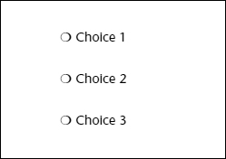
Single menu

Slide 6
Single Menu
In this simplest form of menu, a single screen or window is presented to seek the user's input or request an action to be performed
Single menus conceptually require choices from this single menu only, and no other menus will follow necessitating additional user choices

Slide 7
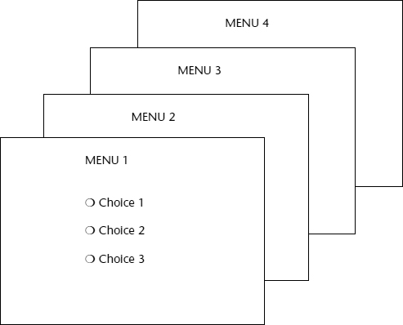
Sequential linear menus

Slide 8
Sequential Linear Menu
Sequential linear menus are presented on a series of screens possessing only one path
The menu screens are presented in a preset order, and, generally, their objective is for specifying parameters or for entering data
The length of the path may be short or long, depending upon the nature of the information being collected

Slide 9
Sequential linear menus
Sequential path menus have several shortcomings. A long sequence may become tedious as menu after menu is presented. The user may not remember an answer to a previous question, a question important to the currently presented choices. The user may also want to return to a previous menu to change an answer or look at an answer, an awkward process that must be allowed

Slide 10
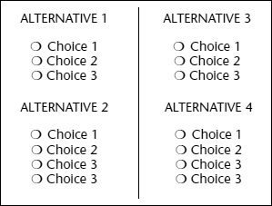
Simultaneous menus

Slide 11
Simultaneous menu
Instead of being presented on separate screens, all menu options are available simultaneously,
All alternatives are visible for reminding of choices, comparing choices, and changing answers. The tedium associated with a long series of sequential menus is greatly reduced.
Problems with simultaneous menus are that for large collections of menu alternatives screen clutter can easily occur, and screen paging or scrolling may still be necessary to view all the choices. This type of menu must also clearly indicate menu choice relationships and dependencies

Slide 12
Hierarchical menus
A hierarchical structure results in an increasing refinement of choice as menus are stepped through, for example, from options, to sub options, from categories to subcategories, from pages to sections to subsections, and so on.
A hierarchical structure can best be represented as an inverse tree, leading to more and more branches as one moves downward through it. Hierarchical structures are characterized by depth and breadth, depth being the number of choice levels one must traverse to reach the destination, breadth being the number of alternatives found at each level.
Menu depth and breadth has been a well-researched topic and will be fully discussed in succeeding pages. Common examples of hierarchical design today are found in menu bars with their associated pull-downs, and in Web sites with their navigation links.

Slide 13
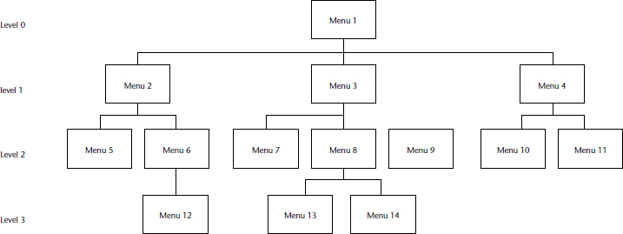
Hierarchical menus.

Slide 14
Connected Menus
Connected menus are networks of menus all interconnected in some manner. Movement through a structure of menus is not restricted to a hierarchical tree, but is permitted between most or all menus in the network.
A connected menu system may be cyclical, with movement permitted in either direction between menus, or acyclical, with movement permitted in only one direction

Slide 15
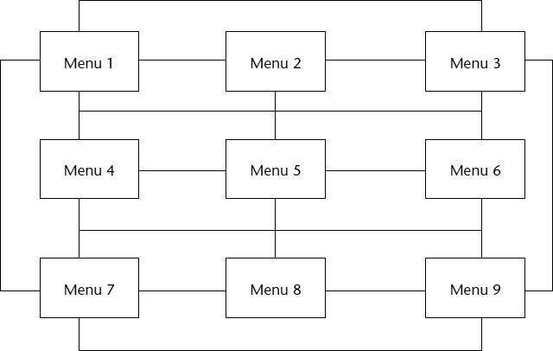
Connected Menus

Slide 16
EVENT-TRAPPING MENUS
Event-trapping menus provide an ever-present background of control over the system's state and parameters while the user is working on a foreground task. They are, in essence, a set of simultaneous menus imposed on hierarchical menus

Slide 17
EVENT-TRAPPING MENUS
Event-trapping menus generally serve one of three functions
(1) They may immediately change some parameter in the current environment (bold a piece of text)
(2) They may take the user out of the current environment to perform a function without leaving the current environment (perform a spell check), or
(3) They may exit the current environment and allow the user to move to a totally new environment (Exit).

Slide 18
Functions of Menus
NAVIGATION TO A NEW MENU:
EXECUTE AN ACTION OR PROCEDURE
DISPLAYING INFORMATION
DATA OR PARAMETER INPUT

Slide 19
Function of menus
NAVIGATION TO A NEW MENU:
Each user selection causes another menu in a hierarchical menu tree to be displayed. The purpose of each selection is to steer the user toward an objective or goal. Selection errors may lead the user down wrong paths, and cost time and, perhaps, aggravation, but these errors are nondestructive and usually undoable.

Slide 20
Function of menus
EXECUTE AN ACTION OR PROCEDURE
A user selection directs the computer to implement an action or perform a procedure. The action may be something like opening or closing a file, copying text, or sending a message. In some cases, execution may only occur after a hierarchical menu tree is navigated. In other cases, actions may be performed as successive hierarchical menus are encountered and traversed

Slide 21
Function of menus
DISPLAYING INFORMATION
The main purpose of selecting a menu choice may simply be to display information. The user may be searching for specific information in a database or browsing the Web. The user's focus is primarily on the information desired and less on the selection function. In many cases, information retrieval may occur only after a hierarchical menu tree is navigated. The content material and the user's interests will determine the paths followed.

Slide 22
Function of menus
DATA OR PARAMETER INPUT
Each selection specifies a piece of input data for the system or provides a parameter value. Data or values may be input on a single menu or spread over a hierarchy of menus. The user's focus is primarily on the information being provided and, again, less on the selection function. Selection errors can be easily corrected if detected by the system.

Slide 23
Content of Menus
MENU CONTEXT
MENU TITLE
CHOICE DESCRIPTIONS
COMPLETION INSTRUCTIONS

Slide 24
Content of Menus
A menu's context provides information to keep the user oriented. This kind of information is critical in complex or hierarchical menu systems, where loss of position or disorientation can easily occur
Verbal linkage involves providing, on the current menu screen, a listing of choices made on previous menus that have led to this position.

Slide 25
Content of Menus
Spatial linkage can be accomplished by graphic methods. Each succeeding menu screen can be displayed overlapping the previous menu screen so a succession of choices can be seen in a single view.

Slide 26
Content of Menus
Menu Title : A menu's title provides the context for the current set of choices. The title must reflect the choice selected on the previously displayed menu.
CHOICE DESCRIPTIONS
Choice descriptions are the alternatives available to the user. These descriptions can range from a mnemonic, numeric, or alphabetized listing of choices, to single words or phrases, to full sentences, or more. The style chosen will reflect the experience of the user (novice or expert), the nature of the choices (well-learned alternatives or not), the nature of the selection mechanism (keyboard or mouse), and the nature of the system (business system application or Web page).

Slide 27
Content of Menus
COMPLETION INSTRUCTIONS
Completion instructions tell users how to indicate their choices. They may include the rationale for why the user is being asked to make this choice and the impact the choice will have on subsequent processes. Explicit instructions may be needed for first time or casual users of a system. Experienced users will find overly verbose instructions unnecessary. The needs of all system users, and the nature of the system, must again be considered in creating this kind of on-screen guidance.

